Slide 1
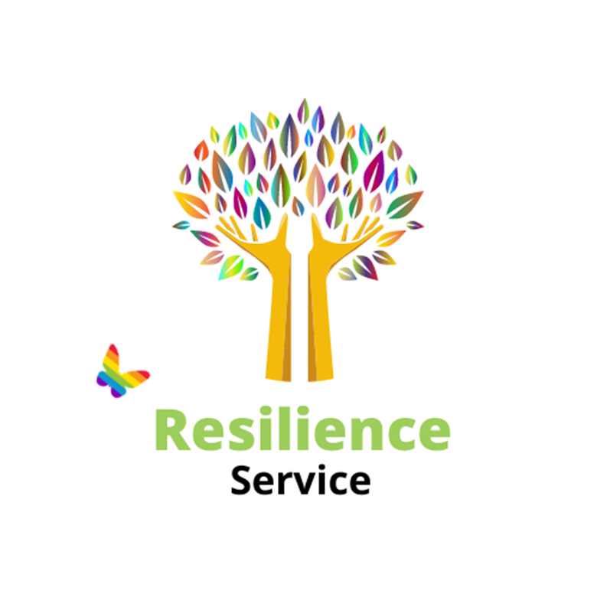

Exam stress presentation

Slide 2
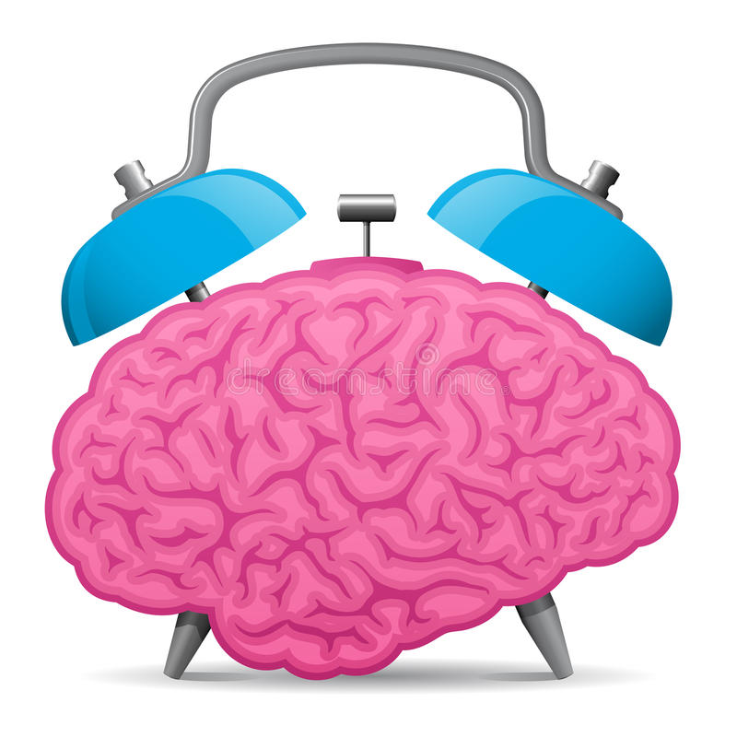
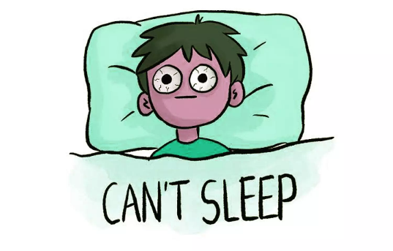
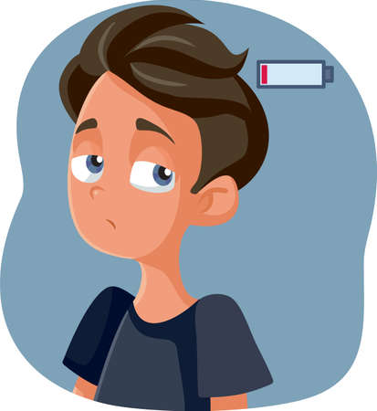
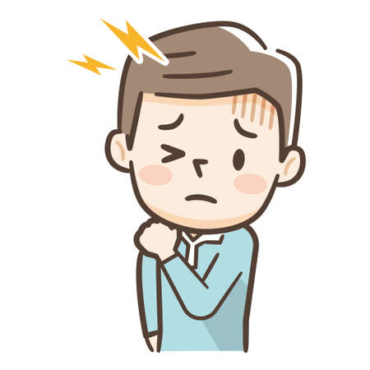
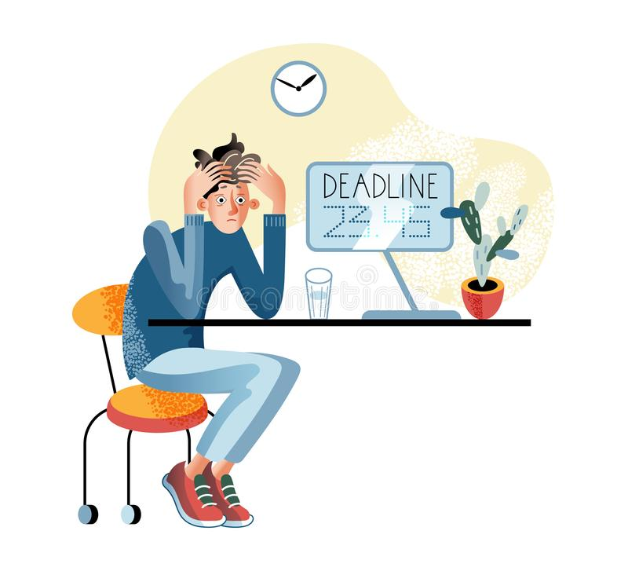
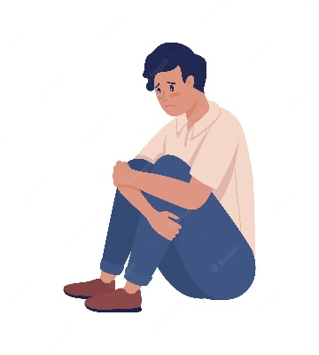
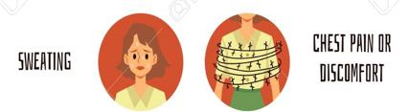
What is Stress?
.
Some signs and symptoms that you might be stressed
Notes:
Stress is a normal emotion to an external trigger like exams. and like any emotion we will all react to it differently. For some of you it could help you work more efficiently, but for others it can feel overwhelming and you might struggle with task and feel you do not know where to start. You may have felt like this about your revision.
We all have the same automatic response to danger called the FIGHT, FLIGHT and FREEZE response. Humans have this automatic fear alarm which triggers a safety response - bodies can go into survival mode whenever their brains perceived danger and as we are all individual our senses and triggers to this fear alarm being activated is individual to us.
When our safety alarm is activated your heart rate and blood pressure increases – to help you focus and reduce the danger our brains and bodies still react in the same way to the things we perceive as dangerous, stressful or worrying. This is why we experience the things we do when we feel stressed!
Some signs that you may be stressed could be
Struggling with sleeping, craving sugar and junk foods. Reduced appetite
Withdrawing from others – feeling isolated and alone or avoiding people/tasks
taking on too much - finding it difficult to meet deadlines
Low mood and low energy
Feeling angry really quickly
Symptoms of stress you could experience:
tense muscles
frequent cold/flus
chest pain/rapid heart beat
Short and heavy breathing
sweating
stomach aches

Slide 3
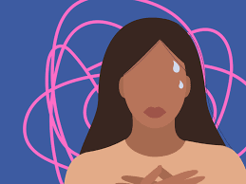
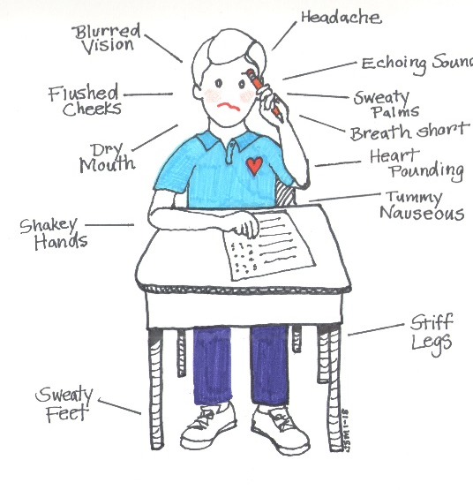
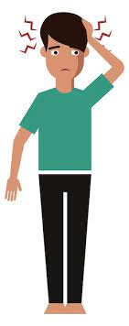
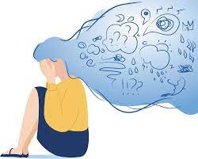
What is anxiety?
Notes:
Anxiety can feel similar in your body but is defined by persistent and excessive worries that don’t go away and aren’t always brought on by an external trigger like exams..
All these feelings are a clues for you that your body needs some help. You can help your anxiety by looking at what you can control - preparing yourself in the morning, have a morning routine give yourself time to get ready, create a play list of music that helps you, have a hot or cold drink, eat breakfast. Have some relaxing time before you go to sleep, we know sleep can be a struggle so getting up can be a struggle. Taking time in the day, even if it’s just 1 minute during toilet break to notice what you’re feeling. Making sure you have some balance in your day not all about study and revision.

Slide 4
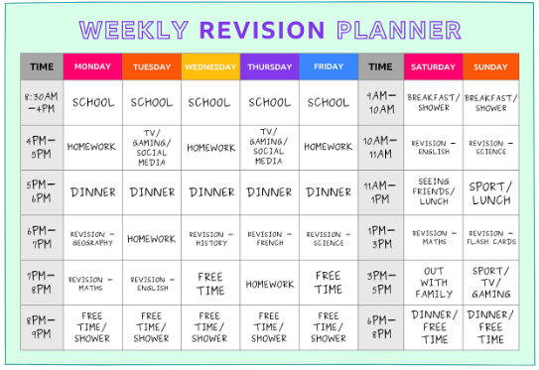

Time management
Preparing for your exams can be a difficult time, to reduce stress create a timetable. This should include free time for yourself where you can plan to relax and have some fun too…
Schedule in time for rest and relaxation!
Images and information sourced from www.bbc.co.uk/bitesize
Notes:
A revision timetable will help you get your revision organised and factor in time for yourself. So, making sure that you plan a balanced exam timetable. This will releave stress and help you to focus better.

Slide 5

Unhelpful Thinking
They are so clever,
why can't I be like
that?
I notice positive things about other people but then compare myself negatively to them.
Images and text sourced from @WeHeartCBT
Notes:
Sometimes we develop unhelpful thinking habits which lead to negative thoughts and feelings. Unhelpful or negative thoughts are normal, but if we think like this all the time then it can have an impact on our mental health. An example of unhelpful thinking can be seen in the picture, this is what we call ‘compare and despair’, we can often compare ourselves negatively against others.
To support ourselves with this, firstly we can start to notice our thoughts in order to become more aware of when this is happening. We have thousands of thoughts each day and they aren’t all facts and truth. Once we start to notice any negative thoughts we can start to challenge them. Think of havignn a conversation in your own mind about the thought. What facts is there to support this, what would you to say to your friend if they said this about themselves,

Slide 6


Slide 7
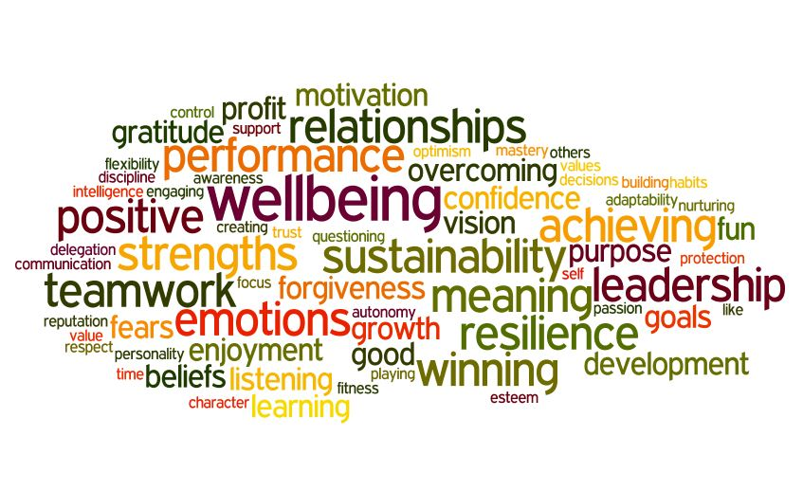
What is wellbeing?
Notes:
Your mental wellbeing is about how you're feeling right now, and how well you can cope with daily life. Our wellbeing can change from moment to moment and day to day, Sometimes it changes because of things that happen to us and sometimes it changes for no reason at all. It can affect the way we feel about ourselves and those around us and about the things we face in our lives.
Why is having a good overall wellbeing important?
feel and express a range of emotions
have confidence and positive self-esteem
have good relationships with others
enjoy the world around you
cope with stress and adapt when things change.
Build your resilience.
Good wellbeing doesn't mean you'll always be happy. It's normal to feel different emotions like sad, angry, frustrated. Remember these are clues for you. But if you struggle with your wellbeing for a long time you might start to find things more difficult to cope with, it would be helpful to get some support.

Slide 8
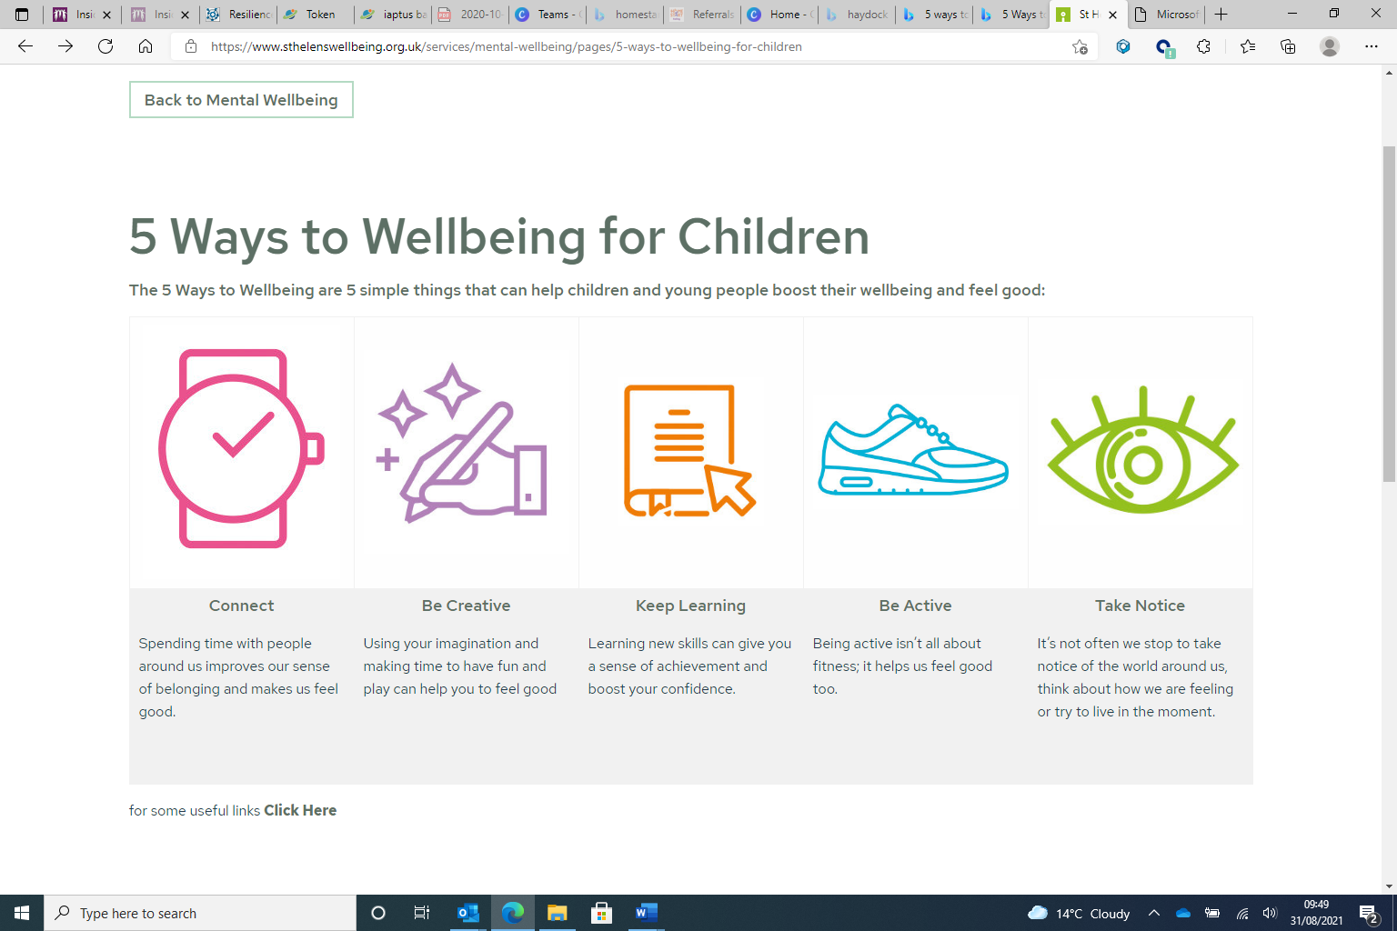
Notes:
Explain that the ‘5 ways to wellbeing’ shows the things what we may need to help us to look after our wellbeing.
Here are some examples of things you may do for each area to look after your wellbeing.
Connect- Connect with the people around you – at home, at school and in your local community. Talk to friends, family, or pets. Spend time socialising. Join a local youth group or sports club. Take up a new hobby – dancing, youth theatre, a martial art.
Be creative- Play and have fun, make something, paint, draw, sing, write a story/poem/song, play an instrument.
Keep learning- Try something new, learning a language or how to cook, developing new skills or going travelling is fun and makes you feel more confident.
Be Active- Regular exercise makes us feel good. Find a physical activity you enjoy –football, swimming, or dance. Going for a walk or run helps you to de-stress.
Take notice- This is about being mindful – appreciating what is around you, being aware of how you feel, noticing the natural world and changing seasons. Enjoying the moment, paying attention to friends and family, and reflecting on your experiences can help you appreciate what matters most to you.

Slide 9
Tips and advice
Stress before the exam
Stress during the exam
Stress after the exam
Eating nourishing food and drink
Get regular sleep
Organisation and preparation
Notice and respond to stress levels
Plan breaks and down time
Focus on you, what do you need and when.
If you feel you are panicking, sit back and take a moment. Regulate your breathing
Let the invigilator know if you fear you are about to have a panic attack.
Read the questions thoroughly and more than once to help you plan your answers.
Work at one exam at a time.
Steer clear of exam post mortems
Try not to compare your answers to your friends
There is life after exams, make plans
Working hard for short period of time.
Notes:
Eat healthily by having breakfast and plenty of fresh fruit and vegetables. Try to avoid junk food.
Avoid alcohol, cigarettes or too much caffeine as this won’t help manage stress.
Get your eight hours sleep. Wind down before bed by putting away your mobile and tablet.
The key to lowering your stress is organisation and preparation. Going into an exam feeling confident because you’ve worked hard is going to be less stressful.
Manage your time. Make a realistic timetable. Stick to it. Everyone approaches revision in different ways so make sure you’ve chosen the method that works best for you.
Plan breaks and treats into your revision schedule in order to reward yourself. This includes exercise breaks.
Plan your social media breaks so that your phone is not interrupting your revision.
Learn to recognise when you are becoming stressed. A break or a chat with someone who knows the pressure you’re under will get things into perspective.
Remember to focus on yourself not your friends, so avoid comparing your revision with that of your classmates.
Surround yourself with a group of people who will motivate you, and who
you can talk to about your exam stress constructively.
If you feel yourself panicking during the exam, sit back for a moment and control your breathing.
Hold your hand on the desk and notice if the desk is cold to touch, focus on your senses. Take in a deep breath and hold for as few seconds and breathe out, making sure your out breath is longer than your in breath.
For one minute count how many slow breaths you can take.
Talk to the invigilator in the room if you fear you might have a panic attack.
Read the questions thoroughly and plan your answers to help you feel in control
Remember to keep things in perspective and steer clear of any exam ‘post-mortems’. It doesn’t matter what your friends wrote as it’s too late to go back and change your answers. Put it behind you – the best thing to do is focus on the next exam.
Remember that there is life after exams. Things might seem intense right now, but it won’t last forever.
There will be a point when the exam is over, so working hard for a short time will pay off when you get your results and feel that achievement.

Slide 10
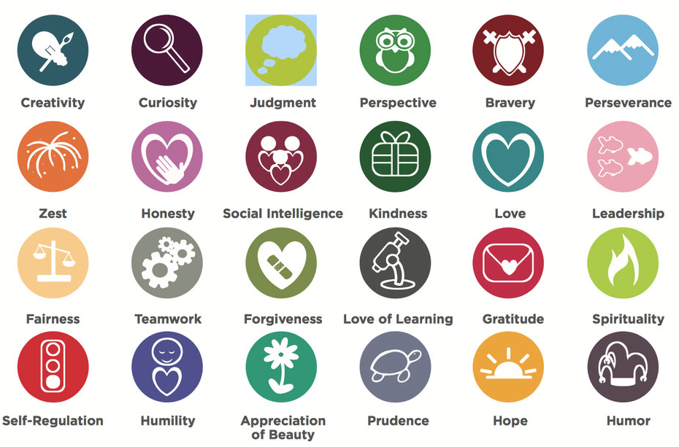
Hopes for the future
Remember that there's more to life than your grades. Exams are only a small part of the picture, and your results don't define who you are.
Know your strengths to help you get through it
Notes:
Keep things in perspective
Remember that there's more to life than your grades.
Exams are only a small part of the picture, and your results don't define who you are.
Lots of people will tell you this, because it’s true - exams aren’t everything.
Think about what you hope for your wider future not just after your exams, you may want to travel and see the world, you may want to live on your own, be a great friend, win a trophy with your sports team, your hopes for the future are unique to you and may be completely separate to your education so keep these in mind.
If you feel all of your hopes are pinned on getting the results you want, please remember that lots of people do not get exactly what they hoped for but are still extremely successful. And there are lots of people around you to support you in your next steps.
STRENGTHS
Use your strengths to help you through any stressful times, for example
Kindness- You may be a kind and generous person to others, remember to also be kind to yourself.
Perseverance- You work hard to finish what you start, reminding yourself of this may help you when faced with lots to do.

Slide 11

Positive Affirmations
I will pass this exam.
I will control my breathing and stay calm.
Affirmations are a powerful and effective way to literally change the way your brain thinks about exams.
I believe in me, I can do this.
I studied hard and will remember all the information I need.
Ignore everyone else, this is only four weeks of your life.
Take the exams one at time.
I am prepared and will try my best.
Notes:
Affirmations are a way of being kind and coaching yourself positively.
Feeling nervous or anxious is normal for most students. If you can’t channel or control your anxiety, however, it could have an effect on your performance.
Using positive affirmations for exam anxiety is one of the ways you can put all those negative thoughts to one side, replace them with positive thoughts, and perform your best in an exam.
Pick some affirmations that will work best for you and repeat them several times a day leading up to exam day, this is a great way to coach yourself and help you to manage any negative thinking.

Slide 12
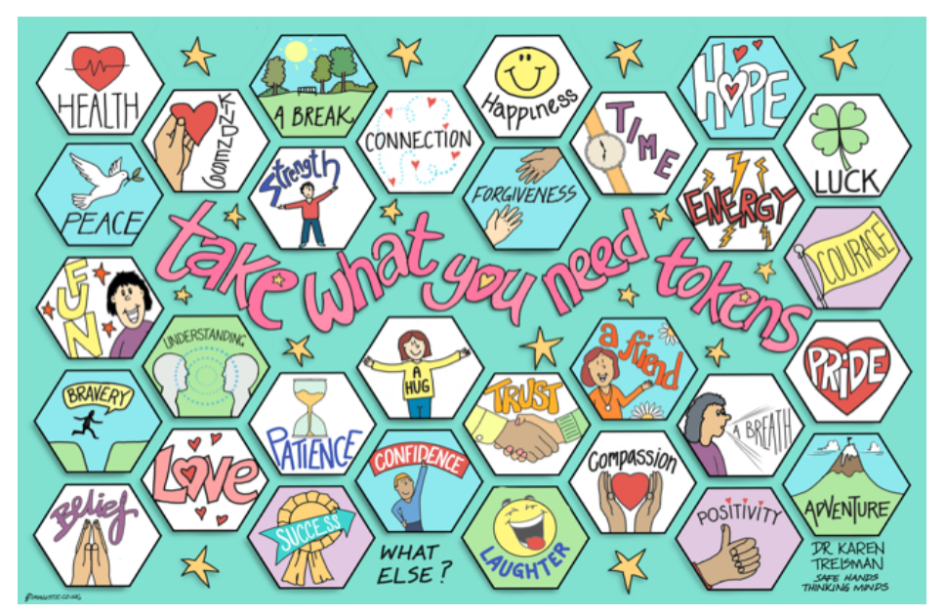
What do you need?
Notes:
Taking responsibility of how you are feeling/ what you need.
We all need something different at different times of the day/week/our lives.
Do you need time out?
To speak to a supporter?
A revision plan?
Time outside?
Self care?

Slide 13
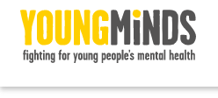
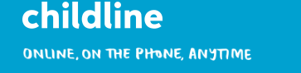

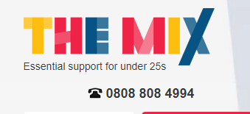
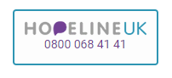
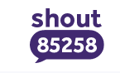
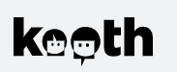
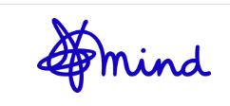
Accessible resources/apps
Notes:
Student minds – exam stress practical resources
https://www.studentminds.org.uk/examstress.html
Young minds
https://www.youngminds.org.uk/young-person/coping-with-life/exam-stress/

Slide 14
Who can I talk to for support?
Form Tutor
Subject Teacher i.e- Geography Teacher
Pastoral care/Heads of year
Barnardo’s
Family

Slide 15

You’ve got this

