Slide 2
What comes to mind when you think of the word Anxiety?
“Anxiety is what we feel when we are worried, tense or afraid – particularly about things that are about to happen, or which we think could happen in the future. Anxiety is a natural human response when we feel that we are under threat. It can be experienced through our thoughts, feelings and physical sensations.” – Mind (2021)

Slide 3
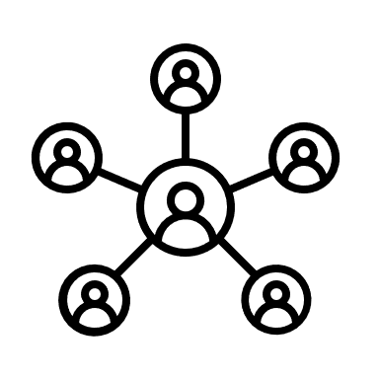
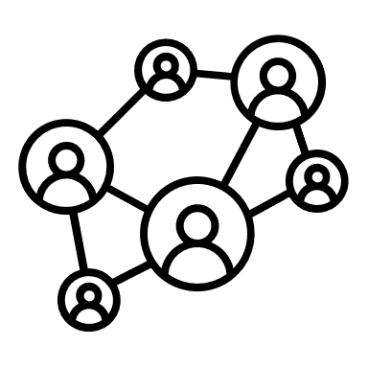
School
Multi
tasking
Money
Exams
Work
Examples of
Stresses, worries
and anxious feelings
Relationships
Health
The future
Family
Friends

Slide 4
What might happen to someone's body when they feel anxious?
Our eyes might dilate,
this makes our
vision blurry
Our digestive system
may briefly stop to save
energy, this can make us feel
like we have butterflies
in our stomach
Our body makes more
energy which can make
us feel dizzy or
light headed
Our kidney produces
energy and adrenaline.
this may make
our hands shake
or foot tap.
Our heart and lungs
work quicker to provide
our muscles with
blood and oxygen
Our mouth stops
producing saliva
to save energy
Our liver creates energy by
releasing sugar, this can give us
a feeling of heartburn

Slide 5
Triesman. K, 2018

Slide 6
Think
Fight/ flight
Emotions
learning
Prefrontal
Cortex
(Thinking brain)
Limbic
System
(emotional
brain)
Analyse
Attachment
Rational
Language
Relationships
Senses
Shelter
Brains develop
from the bottom
up
Brain Stem
(Survival Brain)
Body functions
Food/ drink

Slide 7
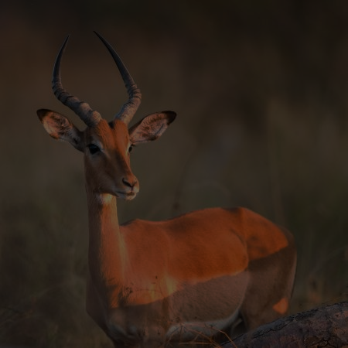
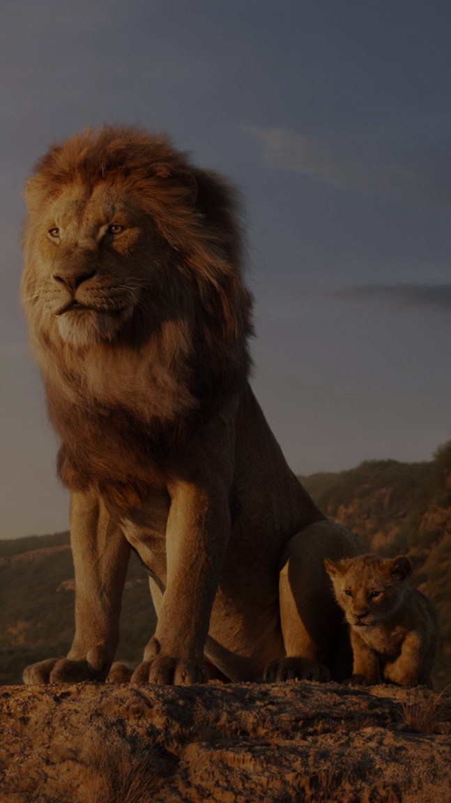
Fight, Flight, Friend, Freeze and Flop response
Fight
Flight
Flop
Freeze
Friend

Slide 8
This disconnection means that our capacity of rational thought, planning, problem solving and empathy temporarily stops.
Challenging their behaviour through shouting, arguments, dismissing , threatening, etc. further imbeds the emotional and survival responses as the thinking brain is offline.

Slide 9
How do we bring the thinking brain back online?
Connect before correct
S
Stay calm, try to not get upset as that contributes to the issue
U
Seek to understand what's happened
R
Reframe and reflect. E.G. So you feel this about this, is that right?
E
Explore options, how can we sort this, how can we manage in a different way moving forward? How can you handle this in a different way in the future?
Stixrud, W, and Johnson, N, (2021)

Slide 10
Talking about anxiety with the
children that you care for
Have feelings of panic
We might feel stress
We might worry about them
What sort of feelings might come up for a parent or carer when talking to their children about anxiety?
We might feel concerned
We might feel frustrated
We might try to stop them talking about it
Might try to fix it for them
We might feel guilt or self blame

Slide 11
Attentional bias

Slide 12
All behaviour is communication
What we don’t say
What we say
How we show how we feel
How we react
What we do
What we don’t do

Slide 13
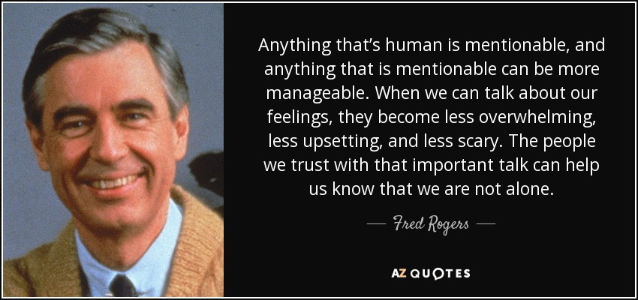
Connect before correct
Showing empathy- ability to understand and share the feelings and stances of another.
Listening
Going at their pace
Eye contact
Being
patient
Not rushing
To find a quick
Fix or solution
Facial
expressions
Not
interrupting
them
Recognising that them talking
To you is a big step and shows they have a lot of trust in you
Not judging, blaming
or shaming them

Slide 14
Square Breath Exercise
Square Breath Exercise
Square Breath Exercise
Start here

Slide 15
Grounding techniques
5
Things that I can see or imagine I can see right now
4
Things that I can hear or imagine I can hear right now
3
Things that I can touch or imagine I can touch right now
2
Things that I can smell or imagine I can smell right now
1
Slow deep breath. In through the nose, out through
the mouth.

Slide 16
Self sooth box
Magazines
Books
Favourite
photos
Puzzles
Chewing gum
Sweets
Playlists
A straw
Chocolate
Nature/ Weather
What is
self soothing?
Popcorn
White noise
Machines/ fans
Mints
Fidget toys
Lavender
Feathers
Rosemary
Animals
Camomile
Fluffy material
Bed Mist/Spray bottle of
diluted fabric softener
Perfume
Orange
Playdough

Slide 17
Contact Details
Link to our website:-
https://www.barnardos.org.uk/what-we-do/services/barnardos-st-helens-resilience-service
Email
Sthresilience@barnardos.org.uk
Telephone
07783 763382

